Slide 1
MIPS
Quick Reference Guide

Slide 2
MIPS: Software Register Convention
0 $0 zero constant 0
1 $at reserved for assembler
2 $v0 expression evaluation &
3 $v1 function results
4 $a0 arguments (caller saves)
5 $a1
6 $a2
7 $a3
8 $t0 temporary: caller saves
. . .
15 $t7
16 $s0 callee saves
. . .
23 $s7
24 $t8 temporary (cont’d)
25 $t9
26 $k0 reserved for OS kernel
27 $k1
28 $gp global pointer
29 $sp stack pointer
30 $fp frame pointer
31 $ra Return Address

Slide 3
Instruction Formats
R-type
I-type
J-type
op
rs
rt
rd
shamt
funct
6 bits
5 bits
5 bits
5 bits
5 bits
6 bits
op
rs
rt
constant or address
6 bits
5 bits
5 bits
16 bits
op
address
6 bits
26 bits

Slide 4
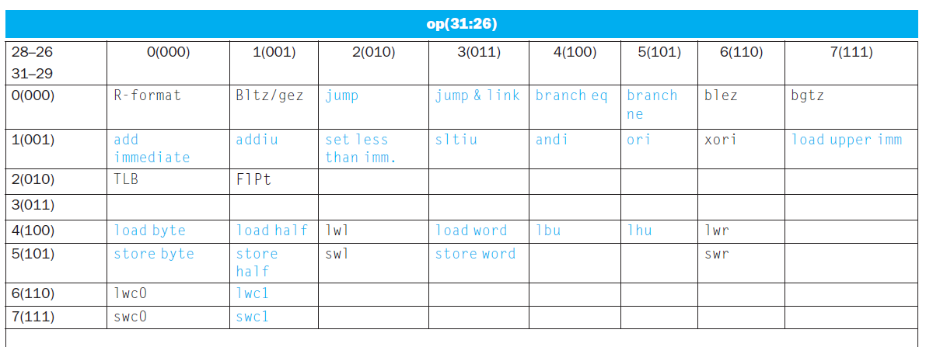
Operation Codes
Every instruction has a 6-bit opcode:
Bits 31-29 specify row
Bits 28-26 specify column

Slide 5
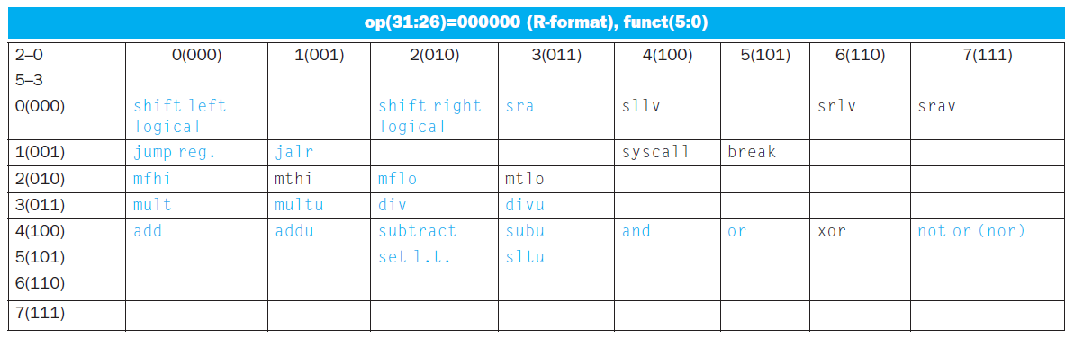
Function Codes
R-type instructions have an opcode of 000000
Instruction is determined by funct field
Bits 5-3 specify row
Bits 2-0 specify column

Slide 6
MIPS Integer Arithmetic Instructions
Instruction Example Meaning Comments
add add $1,$2,$3 $1 = $2 + $3 3 operands; exception possible
subtract sub $1,$2,$3 $1 = $2 – $3 3 operands; exception possible
add immediate addi $1,$2,100 $1 = $2 + 100 + constant; exception possible
add unsigned addu $1,$2,$3 $1 = $2 + $3 3 operands; no exceptions
subtract unsign subu $1,$2,$3 $1 = $2 – $3 3 operands; no exceptions
add imm unsign addiu $1,$2,100 $1 = $2 + 100 + constant; no exceptions
Note: Immediates are sign-extended to form constant for arithmetic operations

Slide 7
MIPS Integer Arithmetic Instructions
Instruction Example Meaning Comments
multiply mult $2,$3 Hi, Lo = $2 x $3 64-bit signed product
multiply unsign multu $2,$3 Hi, Lo = $2 x $3 64-bit unsigned product
divide div $2,$3 Lo = $2 ÷ $3, Lo = quotient
Hi = $2 mod $3 Hi = remainder
divide unsign divu $2,$3 Lo = $2 ÷ $3, Unsigned quotient
Hi = $2 mod $3 Unsigned remainder
Move from Hi mfhi $1 $1 = Hi Used to get copy of Hi
Move from Lo mflo $1 $1 = Lo Used to get copy of Lo

Slide 8
MIPS Logical Instructions
Instruction Example Meaning Comment
and and $1,$2,$3 $1 = $2 & $3 Logical AND
or or $1,$2,$3 $1 = $2 | $3 Logical OR
nor $1,$2,$3 $1 = ~($2 |$3) Logical NOR
and immediate andi $1,$2,10 $1 = $2 & 10 Logical AND w. constant
or immediate ori $1,$2,10 $1 = $2 | 10 Logical OR w. constant
shift left log sll $1,$2,10 $1 = $2 << 10 Shift left by constant
shift right log srl $1,$2,10 $1 = $2 >> 10 Shift right by constant
shift left log var sllv $1,$2,$3 $1 = $2 << $3 Shift left by variable
shift right log var srlv $1,$2, $3 $1 = $2 >> $3 Shift right by variable
Note: Immediates are zero-extended to form constant for logical operations

Slide 9
MIPS Load/Store Instructions
Instruction Example Meaning Comments
store word sw $3, 8($4) Mem[$4+8]=$3 Store word
store halfword sh $3, 6($2) Mem[$2+6]=$3 Stores only lower 16 bits
store byte sb $2, 7($3) Mem[$3+7]=$3 Stores only lowest byte
load word lw $1, 8($2) $1=Mem[8+$2] Load word
load halfword lh $1, 6($3) $1=Mem[6+$3] Load half; sign extend
load half unsign lhu $1, 6($3) $1=Mem[6+$3] Load half; zero extend
load byte lb $1, 5($3) $1=Mem[5+$3] Load byte; sign extend
load byte unsign lbu $1, 5($3) $1=Mem[5+$3] Load byte; zero extend
load upper imm lui $1,40 $1 = 40 << 16 Places immediate into upper 16 bits

Slide 10
MIPS Jump/Branch Instructions
Instruction Example Meaning Comments
Branch on equal beq $s1, $s2, l if (s1 == s2), go to L Equal test and branch
Branch on !equal bne $s1, $s2, l if (s1 != s2), go to L Not equal test and branch
jump j 10000 PC = PC:40000 jump to address
jump register jr $31 PC = $31 jump to address in register
jump and link jal 10000 $31 = PC + 4; Save PC next instruction
PC = 40000 jump to address
Notes: Jump destinations are generally specified by a label, not an absolute address. The destination address is word-aligned, so the instruction field is scaled by 4 to create the word address.

Slide 11
MIPS SLT Instructions
Instruction Example Meaning Comments
set less than slt $1,$2,$3 $1 = ($2 < $3) compare signed <
set less than imm slti $1,$2,100 $1 = ($2 < 100) compare signed < constant
set less than uns sltu $1,$2,$3 $1 = ($2 < $3) compare unsigned <
set l. t. imm. uns. sltiu $1,$2,100 $1 = ($2 < 100) compare unsigned < constant

Slide 12
FP Registers
$f1
$f0
°
°
°
$f31
$f30
FP registers are paired for double-precision. Specify the even register, which holds the less-significant word.

Slide 13
MIPS FP Arithmetic
Instruction Example Meaning Comments
FP add single add.s $f2, $f4, $f6 $f2 = $f4 + $f6 Add single precision
FP add double add.d $f2, $f4, $f6 $f2 = $f4 + $f6 Add double precision
FP subtract single sub.s $f2, $f4, $f6 $f2 = $f4 - $f6 Subtract single precision FP subtract double sub.d $f2, $f4, $f6 $f2 = $f4 - $f6 Subtract double precision
FP multiply single mul.s $f2, $f4, $f6 $f2 = $f4*$f6 Multiply single precision
FP multiply double mul.d $f2, $f4, $f6 $f2 = $f4*$f6 Multiply double precision
FP divide single div.s $f2, $f4, $f6 $f2 = $f4/$f6 Divide single precision
FP divide double div.d $f2, $f4, $f6 $f2 = $f4/$f6 Divide double precision

Slide 14
MIPS FP Load/Store
Instruction Example Meaning
Load FP single lwc1 $f1, 100($s2) $f1 = Mem[$s2+100]
Store FP single swc1 $fl, 100($s2) Mem[$s2+100] = $f1
Load FP double ldc1 $f0, 100($s2) $f0 = Mem[$s2+100], $f1 = Mem[$s2+104]
Store FP double sdc1 $f0, 100($s2) Mem[$s2+100] = $f0 Mem[$s2+104] = $f1

Slide 15
MIPS FP Conditional Branch
Instruction Example Meaning
FP Compare single c.lt.s $f1, $f2 if ($f1 < $f2) cond = 1 else cond = 0
FP Compare double c.lt.d $f2, $f4 if ($f2 < $f4) cond = 1 else cond = 0
FP Branch if True bc1t 25 if (cond == 1) go to PC + 4 + 100
FP Branch if False bc1f 25 if (cond == 0) go to PC + 4 + 100
Comparison Instructions: lt may be replaced with eq, ne, le, gt, ge

Slide 16
MIPS-64
Extension of MIPS-32
Specifies 32 64-bit registers
Instructions remain 32-bits wide

Slide 17
MIPS-64
Load 64-bit Integer LD
Store 64-bit Integer SD
Add 64-bit integers DADD
Subtract 64-bit integers DSUB
Mult. 64-bit integers DMULT
Divide 64-bit integers DDIV
64-bit shifts DSLL, DSRL

